Slide 1
Business Strategy – Bokan
Final Presentation
March 2021

Slide 2
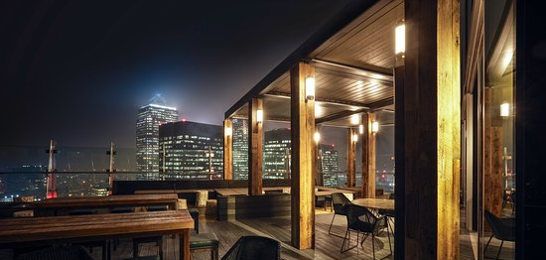


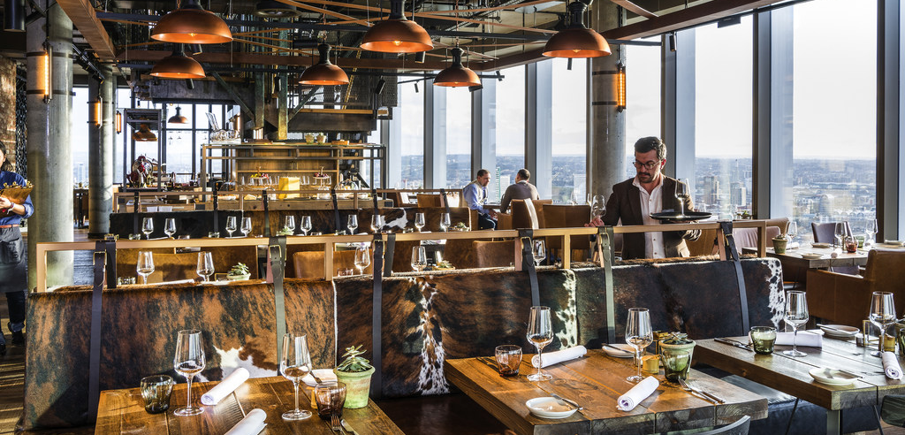

Novotel Canary Wharf – Bokan 37, 38, & 39
Bokan has multiple revenue streams…
… and wants to optimize its margins in a context of uncertainty
Bokan 39 Rooftop Bar & Terrace
Covid-19 pandemic has dramatically reduced the restaurants’ revenues
The management’s objective is to revamp and modernize the restaurants environment
Bokan 37 Restaurant & Bokan 38 Bar
Attract a larger scale of customers using a data-driven approach
The business perimeter encompasses one rooftop bar and terrace, one restaurant and another bar.
We have structured our analysis around those objectives.

Slide 3
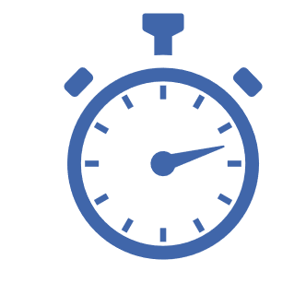


Presentation of the timeline
How we organize this project
Preliminary analysis
In-depth analysis
Closing
Kick-off
meeting
Client meeting
3
Final presentation
Refining business problems and analysis
1
Collecting / scraping data on Internet
Preliminary analysis of textual collected data
Definition of the issues and hypotheses
4
5
January 25th
February 22nd
Deeper analysis
March 15th
2
Scraping data from Tripadvisor and Google Reviews about Bokan 37, 38 and 39. From those collected data:
Conduct a preliminary analysis on the business problems faced by Bokan bars and restaurants
Draft some hypotheses that will be validated or reframed later
Formulate initial recommendations
Redefinition of business problems based on the discussion with the client and documents required during the client meeting
Deeper analysis of the business model and cost structure thanks to financial statements and other key documents
Final presentation with a deliverable and data-driven recommendations to efficiently solve the business issues
1
3
4
5
Mid-term meeting to share our initial analysis and discuss of the hypotheses taken by our team
2

Slide 4
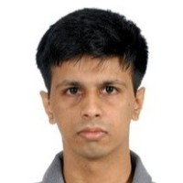
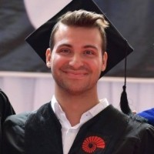
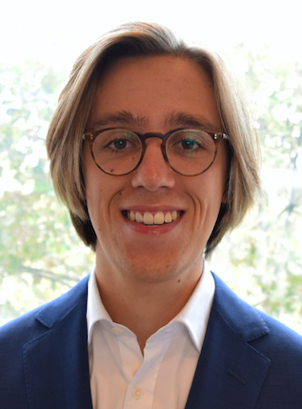
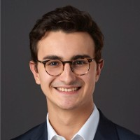
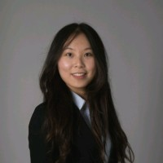
The team
Our team is composed of consultants with different backgrounds and professional experiences
Ajay Srivatsa
Doruk Yasa
Elias Lindbergs
Pierre-Antoine Bannier
Xuwen Liu
Our team comes from a very diverse background: biological chemistry, finance, mathematics, economics, engineering and philosophy.

Slide 5



We adopted a top-down approach to analyse the business issues
We identified the strengths and the weaknesses of the Bokan restaurant & bar
Enhance the strength
Food
Strength
Bokan restaurant and bar reviews
Branding
Weakness
Service
Improve the weakness
We analyzed the case with strength and weakness analysis and then we make correspond recommendations.

Slide 6
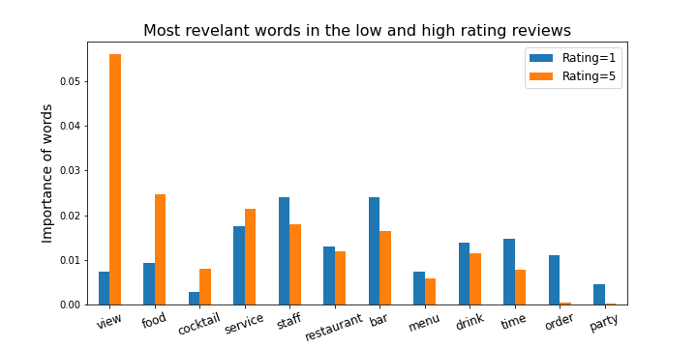

Strengths of Bokan Restaurant & Bar
Great view, tasting food and delicious cocktail are the strength of Bokan
Our approach
Word cleaning
Lemmatization
TF-IDF
Recommendations
Keep ameliorating
the rooftop ambiance
Maintain the high quality of food and cocktail
Refine the menu design
“We really enjoyed a very nice cocktail called 'old venues' and planning to come back to see amazing view from the bar and scenery of the river and city center. Truly recommended.”
” Amazing view and even better cocktails”

Slide 7

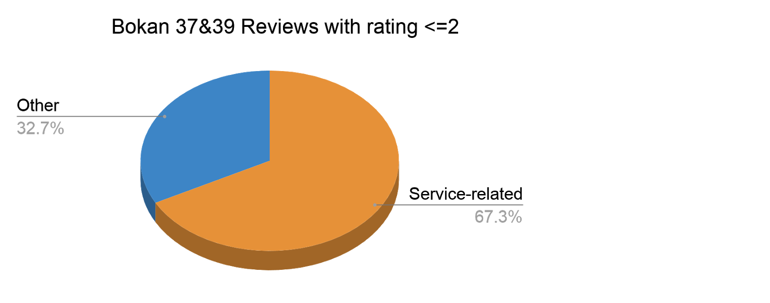
Weakness revealed by low-rating reviews
The service quality has room for improvement
30,000 London restaurant reviews
Word2Vec
Words around one theme
Our approach
Corpus construction
Word2Vec
Recommendations
Only slow service
35%
Improve the quality of service
Slow & Unqualified service
22%
Reduce the service time
Only unqualified service
23%
Other
20%
“We had to wait for 30 minutes for a bottle of wine, unacceptable.”
”The service was painfully slow(took 45min to get our food out after taking orders)”

Slide 8
Recommendations
We identified three areas of improvements to enhance the customer experience and gain market shares
Service
Food
Branding
Efficiency
Quality
Customer Targeting
Qualification
Menu
Customer Satisfaction
We subdivided the issues into three categories and sub-categories in order to have a holistic view of the business issues.

Slide 9
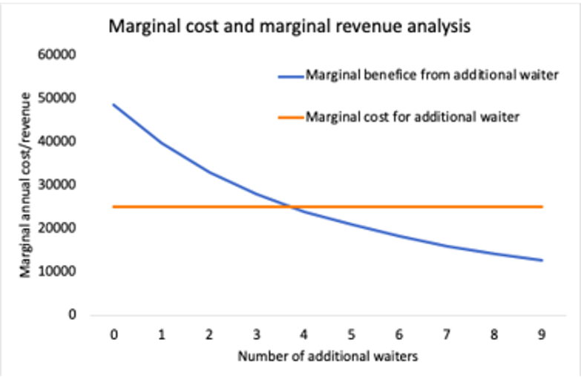
Service recommendations and cost & benefit analysis
Improve the quality of service and reduce the service time
Recommendations
Recruit seasonal staff and temporary servers for busy hour.
Include the rating of service in the KPI of the waiters
More employees’ training focused on the behavior under stress
Standardize serving procedures and track serving time
Reduce service charges for unsatisfied client and provide options of auto-service at the bar
The additional waiter and assistant in the kitchen as well as the employee training could increase the serving efficiency, the customer number per year and thus the revenue per year. But the marginal effect is decreasing and at a certain point saturating.
The annual salary of additional waiter and assistant is 25k pounds. The average sale per customer is 60 pounds.
The dining time consist of fixed eating time and serving time that could be optimized.
Our calculation is based on full recovery situation of the restaurant.

Slide 10
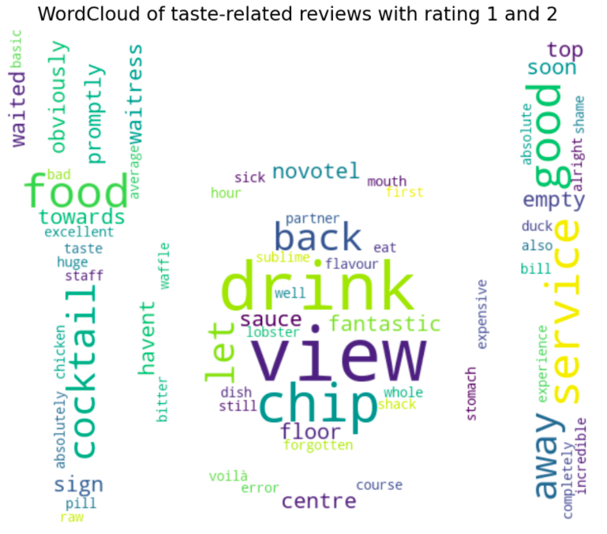
Food-related issues
Some dish compositions are disliked by consumers
Issues that caused some low-ratings
Served cold/raw/overcooked
Overpowering flavors, forgotten components
Limited options
Recommendations
Standardize preparation and serving times
Add a quick double check step for ingredients
Enrich the menu with the most liked dishes
- "I was not impressed with the food. The Nicoise salad did not have any dressing and it was bland. The veal carpaccio lacked in flavour. Even the fries were overcooked bordering being burned. In my opinion with these prices you have to offer food to a higher standard or at least understand balance of flavour when preparing food."
- "All the dishes looked great and sophisticated but the flavours did not follow. It was either plain (prawns and squid dishes lacked flavour) or the flavour combinations were off (lamb and tarragon crumb just didn’t work for me, on top of it being overcooked). The gels and sauces didn’t add any flavours either."

Slide 11
Menu Recommendations & Cost-Benefit Analysis
Few options in the "Mains" can't address to all customer tastes, we recommend making certain customer favorite menu items a mainstay throughout the year
Chicken with foie gras
A white meat option other than fish
Bringing an old, validated, and very liked option
Unit plate cost: 250gr chicken + 25 gr foie gras ~ 2.25£
Only main dish price ~27£
Profit per plate based on only ingredients cost ~24.75£, much higher than average Bokan margin
A vegan twist to the popular burgers
Unit plate cost: ~1.2£ (for Tofu based meat substitute)
Proposed dish price ~14£ (Bokan bar food menu)
Profit per plate based on only ingredients cost ~12.8£
Vegan Burger
Cost calculations are based on Rungis market goods

Slide 12
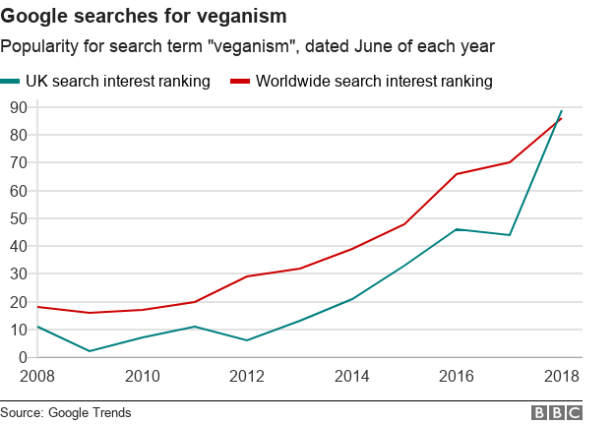
Menu Recommendations & Cost-Benefit Analysis
Introduction of vegan options could increase clientele by 0.6% or 900 more customers a year
Proposed items:
Sauteed Mushrooms: 20g porcini + 3g black truffle + 50g shiitake ~ 6£
Celeriac and Sweet Potato Terrine: ½ celeriac + 7g black truffle + 100g sweet potato ~ 6£
Blackberry Coconut Tart: 200g blackberry + 400ml coconut milk ~ 5£
Price of 3 course meal: 45£
Profit margin per plate: 28£
Expected gross profits: 25,000£
1.2% of UK citizens are vegans, but no vegan only options in 3 course menu
Cost calculations are based on Rungis market prices

Slide 13
Branding-related Recommendations
Bokan's overall brand image should be enhanced to address and satisfy its various target customers
Few important remarks...
Client satisfaction is very important: -If they are satisfied, they come back, become loyal, and recommend to others -If they are not, they are generally lifelong lost and they discourage others not to go Bokan has significant “I won’t come back again” comments
Many customers come to Bokan for special days such as marriage/relationship anniversaries, birthdays, celebrations.. A bad experience is the last thing they want in their most special and happy days, it won’t be forgotten. Bokan has many angry and disappointed customers on such days
Main customer profiles: hotel stays, businesspeople, special occasions, recommendation followers, friends, families, couples
Various tastes including vegan, vegetarian
Adapted very strong Covid-19 safety measures
Disturbance due to loud music
Recommendations
Assign restaurant manager to ask customers their experience at the end, thank for coming, apologize for any inconvenience, ensure compensation for next time and track
Ensure particular care for customers coming on their special days, assign the more experienced waiters to them
Promotions to businesses and hotel customers
Recommended vegan options, enhanced menu to include all red meat, white meat, fish, seafood, pasta, vegeterian, pasta options
Keep the strict sanitary measures, adapt contactless payment
Adjust the music volume to facilitate discussion

Slide 14
Cost-Benefit Sensitivity Analysis of Menu & Staff Recommendations
We base our approach on three scenarios: Gradual recovery, Moderate recovery, Fast recovery & analyze from the reopening date announced by the British government, April 2021, till the end of 2021
Model assumptions
Bokan 37 capacity ~70 people, Lunch + Dinner ~ daily cap 200 people, turnover rate of 1.4
Gradual recovery: 50% cap first 3 months, 60% cap following 3 months, 70% last 3 months Moderate recovery: 60% cap first 3 months, 70% cap following 3 months, 80% last 3 months Fast recovery: 70% cap first 3 months, 80% cap following 3 months, 90% last 3 months
Uniform customer preference on 7 main dishes
Average Bokan dish ingredients cost 30% of price
Bokan main dish price 27£, 3 course menu 45£, average consumption per customer ~ 60£
Annual salary per waiter is 25k£
Gradual increase in the workforce, in line with customer recovery and marginal benefit
Additional generated revenue till year end, based on different scenarios, following chicken dish, vegan menu, staff training and staff hiring recommendations
Scenario | Gradual recovery | Moderate recovery | Fast recovery
Additional Revenue | ~58k £ | ~65k £ | ~72k £

Slide 15
Conclusion
Experience at Bokan is largely enjoyed but could be improved
Bokan is widely acclaimed for its splendid view, exceptional ambience, and delectable cuisine
Restaurant is more favored as compared to the bar
Certain areas could benefit from some key changes:
Service quality improvement by hiring extra staff during peak periods
Widening the food selection by incorporating vegan options and popular dishes
Brand awareness by social media campaigns and customer recommendation
Recommended changes could translate to increased gross earnings of up to 72k£
Bokan enjoys a strong market potential due to its central location and tasteful décor. A greater investment into human capital and better customer targeting could help it further consolidate its position in the post-covid era.

Slide 16
Next Steps
Short-Term and Long-Term roadmap
Covid Period
Bar only with reservation (limited people covid policy), hourly staying fee
Make promotions to businesses and hotel customers
Price increase
Focus on staff training
Post-Covid
Hire more waiters, cooks inline with marginal benefit and capacity
Continuous quality training programs, build a Bokan culture
Happier, loyal customers
Short term recovery by additional revenue streams
More recommendations
Building a great brand name and much better image

Slide 17
Thank you for your attention!
Any questions?

Slide 18
Appendix

Slide 19
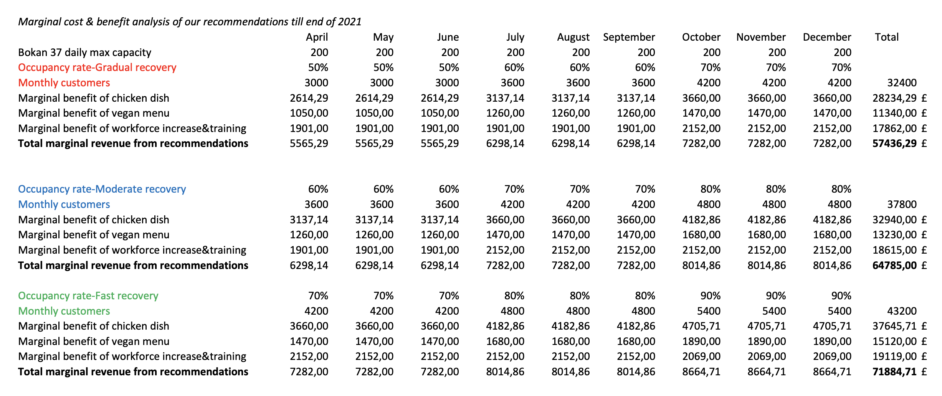
Cost-Benefit Sensitivity Analysis of Menu & Staff Recommendations
Based on the stated assumptions with incremental benefit/cost approach

